Slide 1
PRESENTATION ON SOLVING PROBLEMS USING THE KNOWLEDGE OF ALGORITHM DEVELOPMENT, CONTROL STRUCTURES, AND MODULES ONE TO
By Group 18

Slide 2
Details of Group 18 Members
 | NAME | REG NUMBER | PROGRAM
1 | UHURU DENISH BRIAN | BU/UP/2024/3841 | WAR
2 | TUMUHAISE SARAH | BU/UG/2024/2674 | AMI
3 | MUKHOOLI ELIJAH | BU/UG/2024/2586 | MEB
4 | OMARA PASCHAL KELLY | BU/UP/2024/1063 | WAR
5 | AUMA DIANA | BU/UP/2024/1020 | WAR
6 | NANDAULA CATHERINE | BU/UP/2024/4322 | AMI
7 | NABAWEESI CLAIRE | BU/UP/2024/1046 | WAR
8 | ENAMU REAGAN EGIMU | BU/UG/2024/2672 | APE
9 | NAKAWEESA LINNET | BU/UP/2024/4327 | APE
10 | OLUK CHRISTIAN GLEN | BU/UP/2024/3842 | WAR

Slide 3
TASK GIVEN
In your different groups, utilize the knowledge of algorithms development, control structures and modules 1-4 on the following problems
All Numerical approximate methods for finding the solutions to functions, these include but are not limited to ; Newton Raphson
All methods for solving differential equations numerically these include but are not limited to; Euler, Runge-kutta.
Ensure to apply a and b on a practical real world problem
Note: Requirements; ensure that different methods are stated on similar problems each (minimum of 2). This will help u to plot graphs that compare the problems analytical solutions to the solutions obtained by the different methods along with the computation time.

Slide 4
Solution to the question
Methods used in the estimation of roots include;
Newton-Raphson method
Secant method
Bisection method
Fixed-Point iteration method

Slide 5
Codes used
%%Root Finding using Newton-Raphson and Secant Methods
clc; clear; close all;
f = @(x) x.^3 - 5*x + 3; % Function
df = @(x) 3*x.^2 - 5; % Derivative for Newton-Raphson
% Initial guesses
x0 = 1; % initial guess for Newton-Raphson
x1 = 0; % first guess for Secant
x2 = 1; % second guess for Secant
tol = 1e-6;
maxIter = 50;

Slide 6
Continuation of Codes used
% Newton-Raphson
tic;
for k = 1:maxIter
x_new = x0 - f(x0)/df(x0);
if abs(x_new - x0) < tol
break;
end
x0 = x_new;
end
NR_root = x_new;
NR_time = toc;

Slide 7
Continuation of Codes used
% Secant Method
tic;
for k = 1:maxIter
x_new = x2 - f(x2)*(x2-x1)/(f(x2)-f(x1));
if abs(x_new - x2) < tol
break;
end
x1 = x2;
x2 = x_new;
end
Sec_root = x_new;
Sec_time = toc;
fprintf('Newton-Raphson Root: %.6f (time = %.6f s)\n', NR_root, NR_time);
fprintf('Secant Method Root: %.6f (time = %.6f s)\n', Sec_root, Sec_time);
% Root Finding using Bisection and Fixed-Point Iteration
clc; clear; close all;

Slide 8
Continuation of Codes used
% Root Finding using Bisection and Fixed-Point Iteration
clc; clear; close all;
f = @(x) x.^3 - 5*x + 3; % Function
%% Bisection Method
a = 0; b = 1; % Interval [a,b] (choose where f(a)*f(b)<0)
tol = 1e-6;
maxIter = 50;
if f(a)*f(b) > 0
error('Choose different interval, no sign change.');
end

Slide 9
Continuation of Codes used
tic;
for k = 1:maxIter
c = (a+b)/2; % Midpoint
if abs(f(c)) < tol % Check convergence
break;
elseif f(a)*f(c) < 0
b = c; % Root lies in [a,c]
else
a = c; % Root lies in [c,b]
end
end
Bisection_root = c;
Bisection_time = toc;
%% Display Results
fprintf('Bisection Root: %.6f (time = %.6f s, iterations=%d)\n', Bisection_root, Bisection_time, k);
fprintf('Fixed-Point Root: %.6f (time = %.6f s, iterations=%d)\n', Fixed_root, Fixed_time, k);

Slide 10
Continuation of Codes used
% Solving ODE using Euler and Runge-Kutta
clc; clear; close all;
f = @(x,y) -2*y; % dy/dx = -2y
x0 = 0; y0 = 1; % initial condition
h = 0.1; % step size
xf = 5; % final x
N = (xf-x0)/h;

Slide 11
Continuation of Codes used
% Arrays
x = x0:h:xf;
y_euler = zeros(1,length(x));
y_rk4 = zeros(1,length(x));
y_exact = exp(-2*x);
% Initial values
y_euler(1) = y0;
y_rk4(1) = y0;

Slide 12
Continuation of Codes used
% Euler Method
tic;
for i = 1:N
y_euler(i+1) = y_euler(i) + h*f(x(i), y_euler(i));
end
Euler_time = toc;
% RK4 Method
tic;
for i = 1:N
k1 = h*f(x(i), y_rk4(i));
k2 = h*f(x(i)+h/2, y_rk4(i)+k1/2);
k3 = h*f(x(i)+h/2, y_rk4(i)+k2/2);
k4 = h*f(x(i)+h, y_rk4(i)+k3);
y_rk4(i+1) = y_rk4(i) + (k1+2*k2+2*k3+k4)/6;
end
RK4_time = toc;

Slide 13
Continuation of Codes used
% Plot
figure;
plot(x, y_exact, 'k-', 'LineWidth', 2); hold on;
plot(x, y_euler, 'r--o');
plot(x, y_rk4, 'b--s');
legend('Exact','Euler','RK4');
xlabel('x'); ylabel('y');
title('Numerical vs Analytical Solutions');
fprintf('Euler Method time: %.6f s\n', Euler_time);
fprintf('RK4 Method time: %.6f s\n', RK4_time);

Slide 14
Practical question used in daily life to apply the above methods
Qn. A metal rod heated at 90⁰c is left to cool in a workshop where the surrounding temperature is 25⁰c if the cooling constant is 0.1per min, predict the rod’s temperature for the next 60minutes using;
a) The analytical solution of newton’s law of cooling.
b) Euler’s method
c) Runge-Kutta 4 method with a step size of 1min. compare the results.

Slide 15
Solution to the question
%% Newton's Law of Cooling
clc; clear; close all;
% Parameters
T0 = 90; % Initial temperature (°C)
T_room = 25; % Room temperature (°C)
k = 0.1; % Cooling constant (1/min)
t_final = 60; % Simulate 60 minutes
h = 1; % Step size (1 min)
% Time vector
t = 0:h:t_final;
% Analytical solution
T_exact = T_room + (T0 - T_room)*exp(-k*t);

Slide 16
Continuation of Codes used
%% Euler Method
T_euler = zeros(size(t));
T_euler(1) = T0; % initial condition
for i = 1:length(t)-1
T_euler(i+1) = T_euler(i) + h*(-k*(T_euler(i)-T_room));
end
%% Runge-Kutta 4 (RK4) Method
T_rk4 = zeros(size(t));
T_rk4(1) = T0; % initial condition
for i = 1:length(t)-1
f = @(T) -k*(T - T_room);
k1 = h*f(T_rk4(i));
k2 = h*f(T_rk4(i) + k1/2);
k3 = h*f(T_rk4(i) + k2/2);
k4 = h*f(T_rk4(i) + k3);
T_rk4(i+1) = T_rk4(i) + (k1 + 2*k2 + 2*k3 + k4)/6;
end

Slide 17
Continuation of Codes used
%% Plot Results
figure;
plot(t, T_exact, 'k-', 'LineWidth', 2); hold on;
plot(t, T_euler, 'ro--');
plot(t, T_rk4, 'bs--');
xlabel('Time (min)');
ylabel('Temperature (°C)');
legend('Exact','Euler','RK4');
title('Newton's Law of Cooling: Analytical vs Numerical');
grid on;

Slide 18
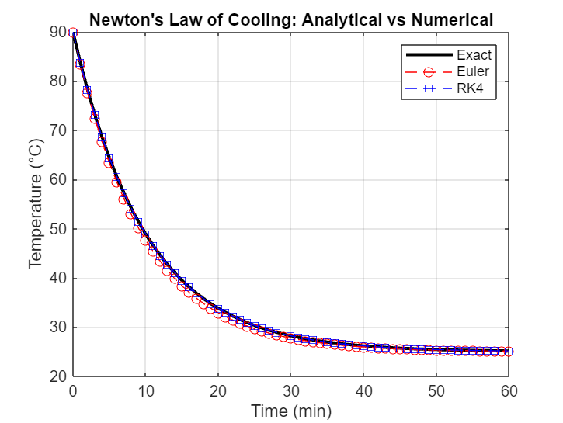
Continuation of Codes used

Slide 19
Explanation to the graph;
The graph above consists of three curves . the plot demonstrates the way newton’s law of cooling works in practice and shows how the different numerical methods change. Euler’s method, is a bit simple but less accurate RK4 gives a better approximation which is almost similar to the exact solution. The methods above show the same physical behavior which is an exponential cooling of the object as it approaches room temperature of 25⁰c over time.

Slide 20
Conclusion;
For the various numerical methods of finding roots, we realized that the number of iterations for a given method vary according to the initial value; x₀ chosen. Newton is very fast. Secant methods are intermediate in speed. Newton and Secant can fail if x₀ is not close to x ∗. We got hardships in coming up with the codes which required us to utilize the programming and data visualization skills with also visiting the internet for the tutorials.

